Slide 1
CS7/8745 : Machine Learning Instructor: Salim Sazzed Department of Computer Science University of Memphis

Slide 2
Linear and Logistic Regression

Slide 3
Regression Analysis
A regression is a statistical technique that relates a dependent variable to one or more independent (explanatory) variables.
Explain the impact of changes in an independent variable on the dependent variable

Slide 4
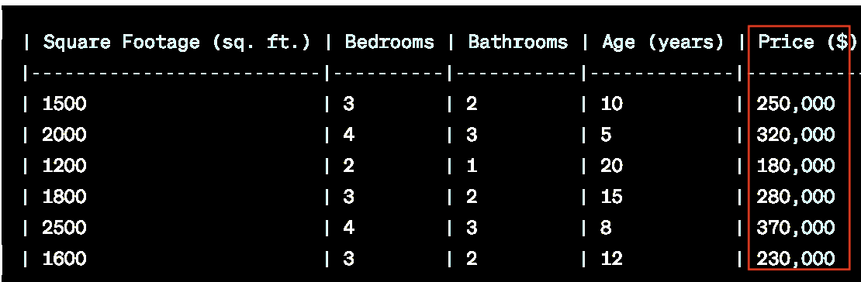
Regression analysis is used to:
Predict the value of a dependent variable based on the value of at least one independent variable
Dependent variable: the variable we wish to predict or explain
Independent variable: the variable used to predict or explain the dependent variable (predictor).

Slide 5
Simple Linear Regression Model
House Price (Y) Vs house Size (X)
Only one independent variable, X
Relationship between X and Y is described by a linear function
Changes in Y are assumed to be related to changes in X

Slide 6
Simple Linear Regression
The simple linear regression equation provides an estimate of the population regression line
Estimated (or predicted) Y value for observation i
b₀ is the estimated mean value of Y when the value of X is zero
b₁ is the estimated change in the mean value of Y as a result of a one-unit increase in X
Estimate of the regression intercept
Estimate of the regression slope
Value of X for observation i

Slide 7

Simple Linear Regression Example
A real estate agent wishes to examine the relationship between the selling price of a home and its size (measured in square feet)
A random sample of 10 houses is selected
Dependent variable (Y) = house price in $1000s
Independent variable (X) = square feet

Slide 8
Simple Linear Regression Example: Data
House Price in $1000s (Y) | Square Feet (X)
245 | 1400
312 | 1600
279 | 1700
308 | 1875
199 | 1100
219 | 1550
405 | 2350
324 | 2450
319 | 1425
255 | 1700

Slide 9
Simple Linear Regression Example: Scatter Plot
House price model: Scatter Plot
https://www.ncl.ac.uk/webtemplate/ask-assets/external/maths-resources/statistics/regression-and-correlation/simple-linear-regression.html
https://www.analyticsvidhya.com/blog/2021/10/everything-you-need-to-know-about-linear-regression/

Slide 10

Creating a simple linear regression model involves fitting a linear relationship between two variables, typically denoted as "x" (the independent variable) and "y" (the dependent variable).
The goal is to find a line of best fit that minimizes the (root) sum of the squared differences between the observed data points and the predicted values on the line.
The Root Mean Squared Error is the square root of the variance of the residuals. It specifies the absolute fit of the model to the data i.e. how close the observed

Slide 11
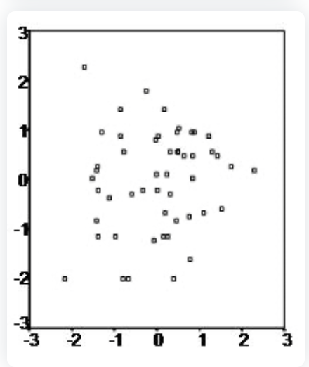
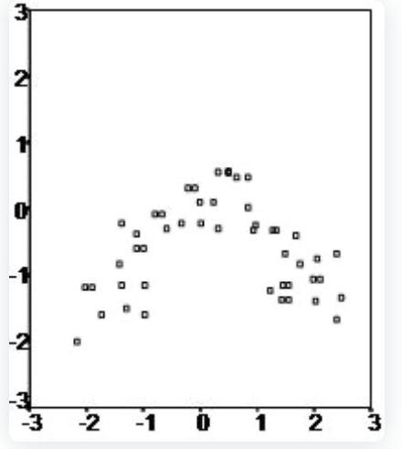
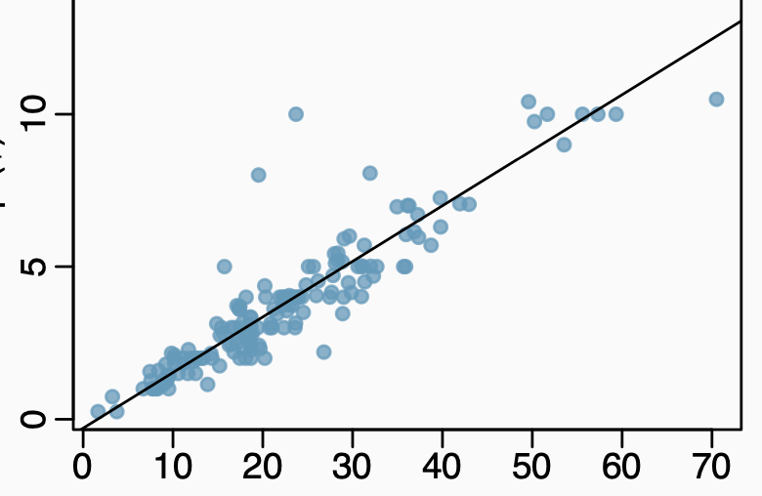
Some conditions:
Linearity
Linear
Non-Linear
2. Constant variability: The variability in a data set should be consistent across all data points, with no extreme outliers (e.g., Normal Distribution, Binomial Distribution).

Slide 12
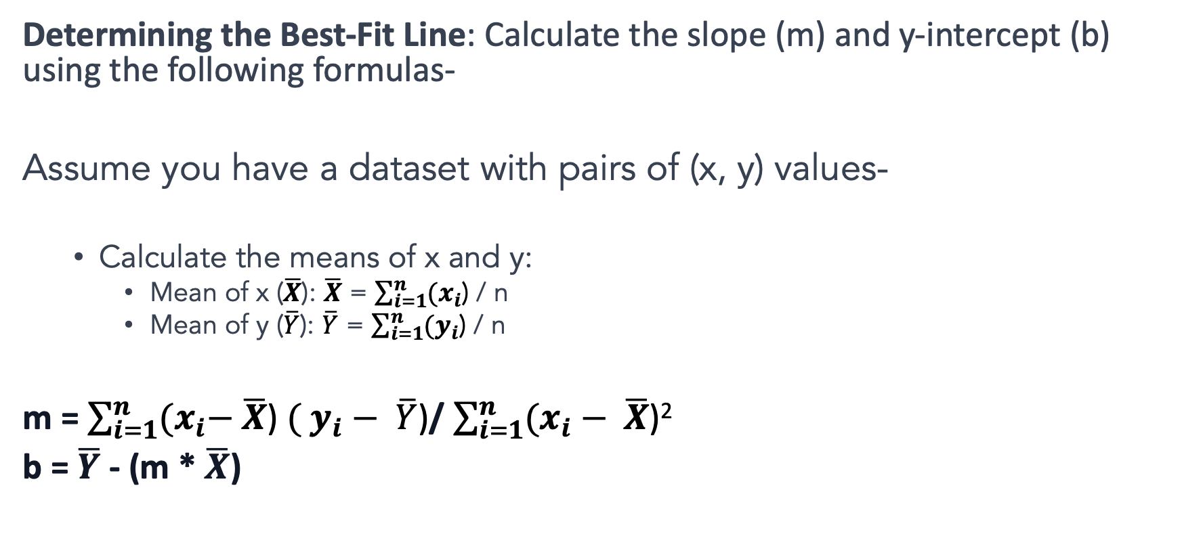
Determining the Best-Fit Line: Calculate the slope (m) and y-intercept (b) using the following formulas-
Assume you have a dataset with pairs of (x, y) values-
Calculate the means of x and y:
Mean of x ($\overline{X}$): $\overline{X}$ = $\sum_{i=1}^{n}{{(x}_{i}\text{)}}$ / n
Mean of y ($\overline{Y}$): $\overline{Y}$ = $\sum_{i=1}^{n}{{(y}_{i}\text{)}}$ / n
m = $\sum_{i=1}^{n}{{(x}_{i}− \overline{X}\text{)} ( y_{i}− \overline{Y}\text{)}}$/ $\sum_{i=1}^{n}{(x_{i}− \overline{X}\text{)}\text{2 }}$
b = $\overline{Y}$ - (m * $\overline{X}$)

Slide 13
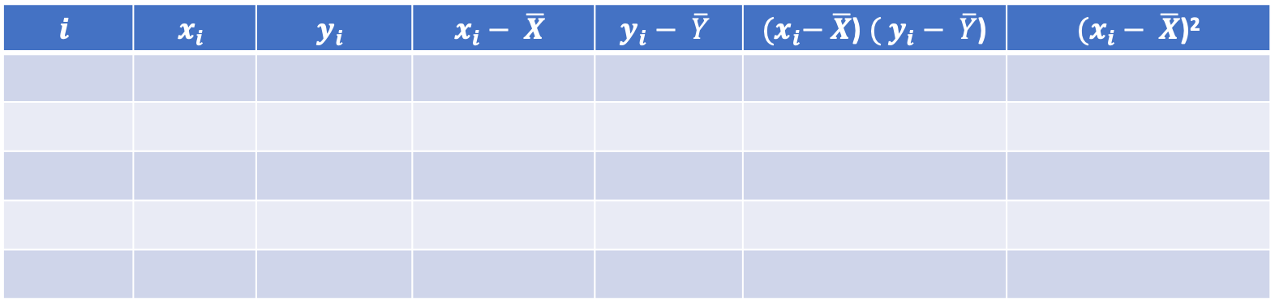
Compute the value of m and b
X | 8 | 2 | 11 | 6 | 5 | 4 | 12 | 9
Y | 3 | 10 | 3 | 6 | 8 | 12 | 1 | 4
$$i$$ | $$x_{i}$$ | $$y_{i}$$ | $$x_{i}− \overline{X}$$ | $$y_{i}− \overline{Y}$$ | ${(x}_{i}− \overline{X}$) $( y_{i}− \overline{Y}$) | $(x_{i}− \overline{X}$)²

Slide 14
Check Normality
Perform the Regression:
Calculate Residuals:
Residual = Y - (a + bX)
Create a Histogram for Residuals:
Visual Inspection:
If the histogram of residuals appears approximately normal (bell-shaped), it suggests that the assumption of normally distributed errors is met for the linear regression model.
If the histogram has substantial skewness or kurtosis or shows a clear departure from normality, it may indicate that the assumptions of the linear regression model are violated.

Slide 15
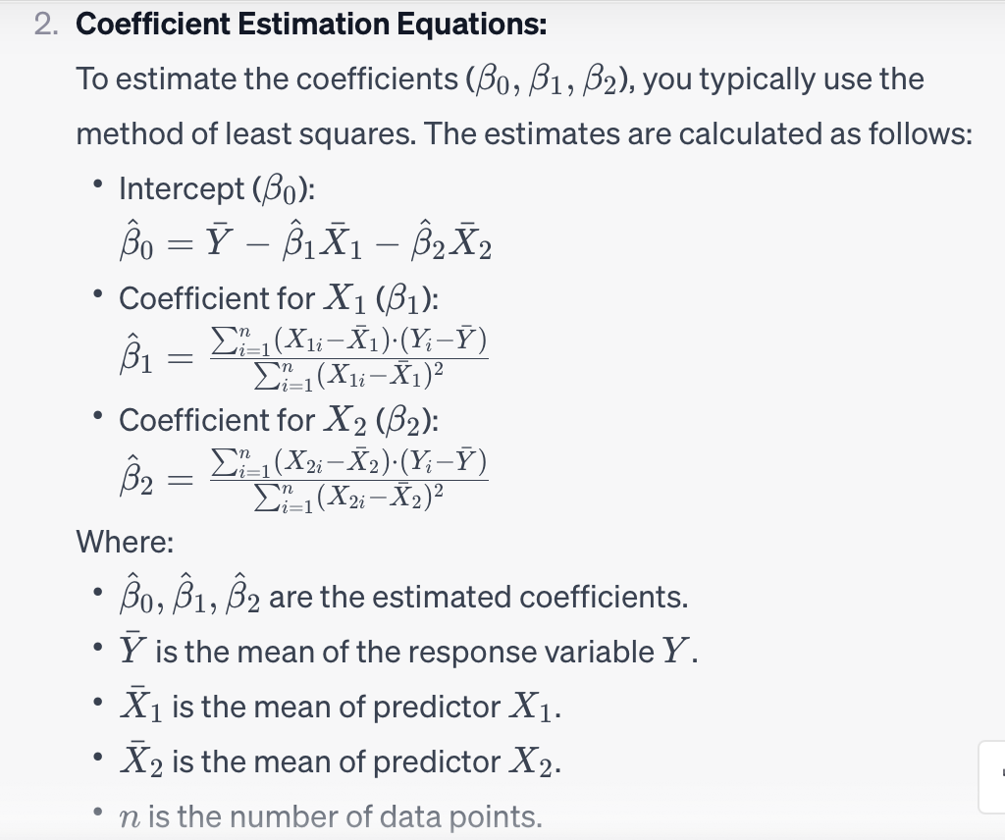
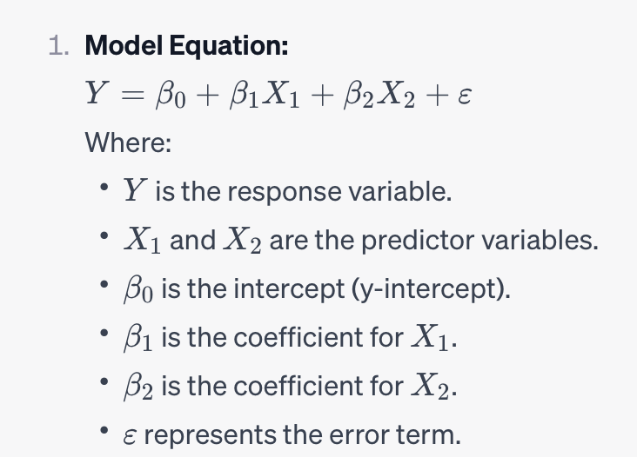
Multiple linear regression with two predictor variables (X1​ and X2​), the linear regression model can be computed using following equation

Slide 16
import numpy as np
from sklearn.linear_model import LinearRegression
# Sample data with two predictors
X = np.array([[1, 2], [2, 4], [3, 5], [4, 6], [5, 8]])
Y = np.array([2, 4, 5, 4, 6])
# Create and fit the multiple linear regression model
model = LinearRegression()
model.fit(X, Y)
# Print the coefficients
print("Intercept (β₀):", model.intercept_)
print("Coefficients (β₁, β₂):", model.coef_)

Slide 17
What is Logistic Regression?
Logistic regression is a classification algorithm used to examine relationships between independent variables (predictors) and a dependant variable (criterion)
The main difference is in logistic regression, the target is nominal (predicting group membership). For example, do age and gender predict whether one signs up for swimming lessons (yes/no)
Its actually not regression, rather classification…
https://careerfoundry.com/en/blog/data-analytics/what-is-logistic-regression/

Slide 18
Types of Logistic Regression
There are primarily 2 types of logistic regression: (1) Binary and (2) Multinomial models. The difference lies in the types of the criterion variable
Binary logistic regression is for a dichotomous criterion (i.e., 2-level variable)
Multinomial logistic regression is for a multicategorical criterion (i.e., a target variable with more than 2 levels)

Slide 19
For binary regression, we calculate the conditional probability of the dependent variable Y, given independent variable X
It can be written as P(Y=1|X) or P(Y=0|X)
This is read as the conditional probability of Y=1, given X or conditional probability of Y=0, given X.

Slide 20
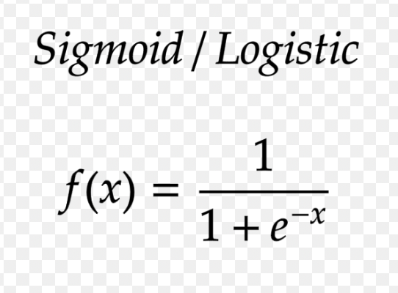
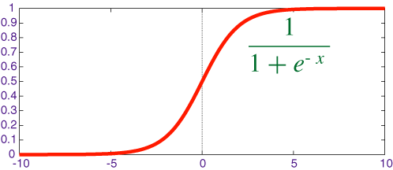
Sigmoid Function:
The sigmoid function is used to model the probability of an example belonging to a particular class. It's a fundamental part of logistic regression.
The sigmoid function takes the linear combination of features and weights and maps it to a probability value between 0 and 1.

Slide 21
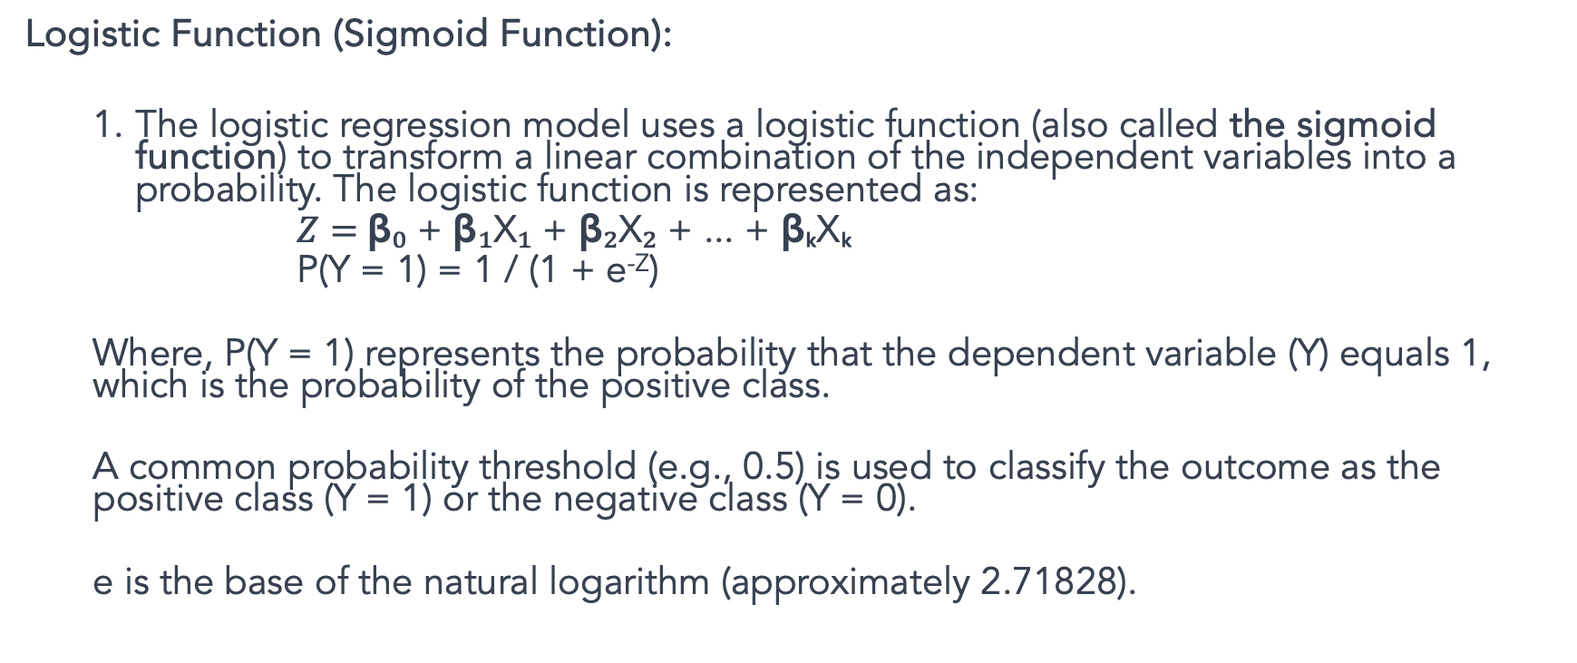
P(Y |X) is approximated as a sigmoid function applied to a linear combination of input features
Logistic Function (Sigmoid Function):
The logistic regression model uses a logistic function (also called the sigmoid function) to transform a linear combination of the independent variables into a probability. The logistic function is represented as:
$Z=$β₀ + β₁X₁ + β₂X₂ + ... + βₖXₖ
P(Y = 1) = 1 / (1 + e^{-Z})
Where, P(Y = 1) represents the probability that the dependent variable (Y) equals 1, which is the probability of the positive class.
A common probability threshold (e.g., 0.5) is used to classify the outcome as the positive class (Y = 1) or the negative class (Y = 0).
e is the base of the natural logarithm (approximately 2.71828).

Slide 22
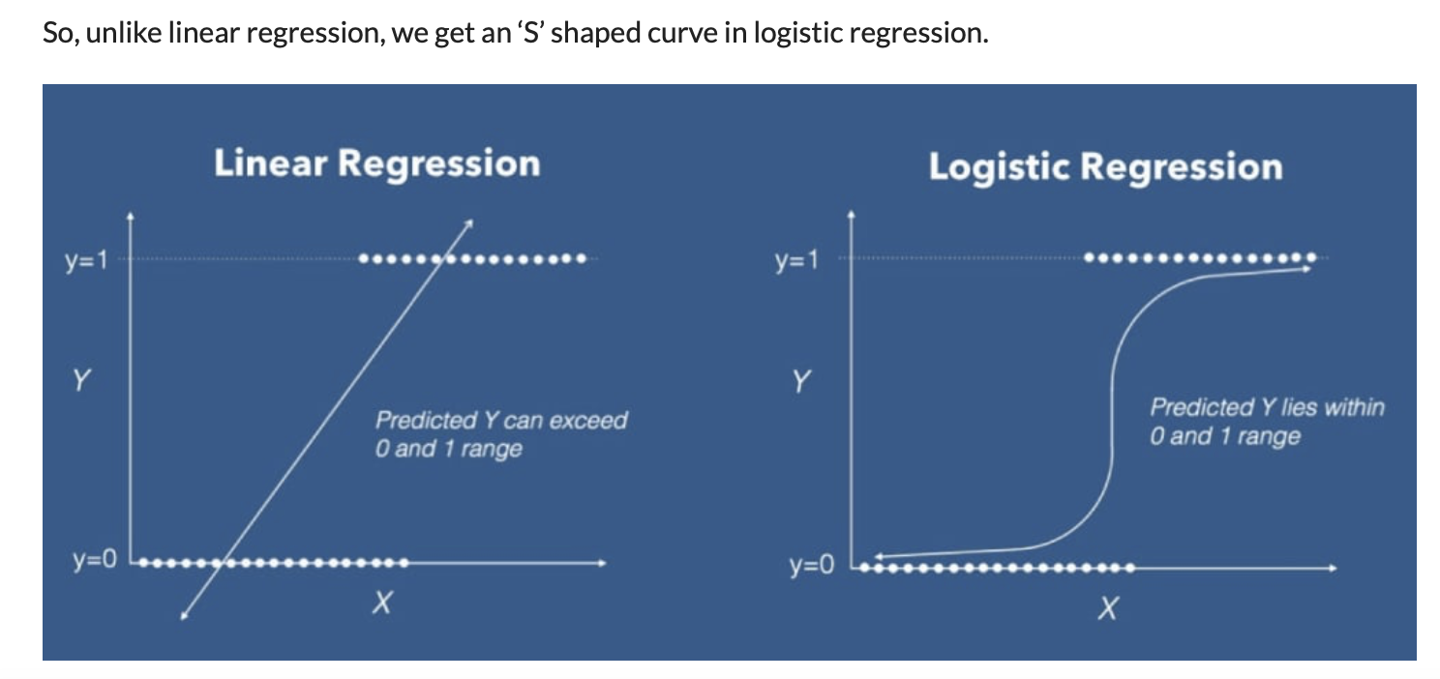

Slide 23
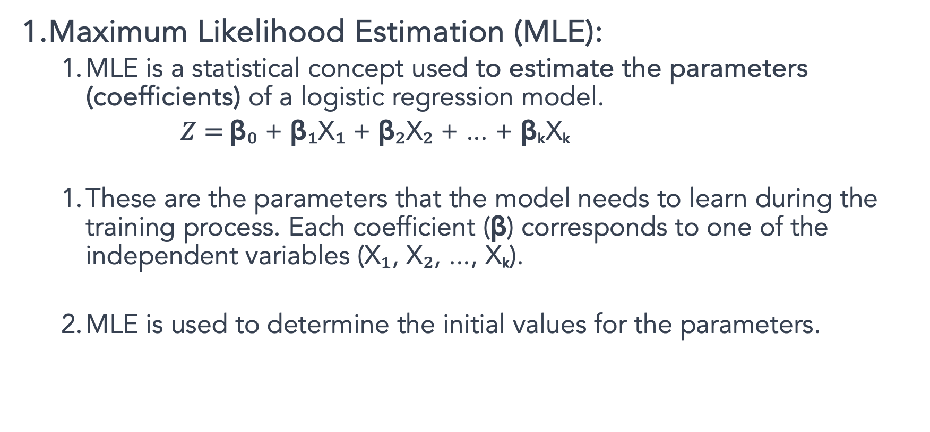
Maximum Likelihood Estimation (MLE):
MLE is a statistical concept used to estimate the parameters (coefficients) of a logistic regression model.
$Z=$β₀ + β₁X₁ + β₂X₂ + ... + βₖXₖ
These are the parameters that the model needs to learn during the training process. Each coefficient (β) corresponds to one of the independent variables (X₁, X₂, ..., Xₖ).
MLE is used to determine the initial values for the parameters.

Slide 24
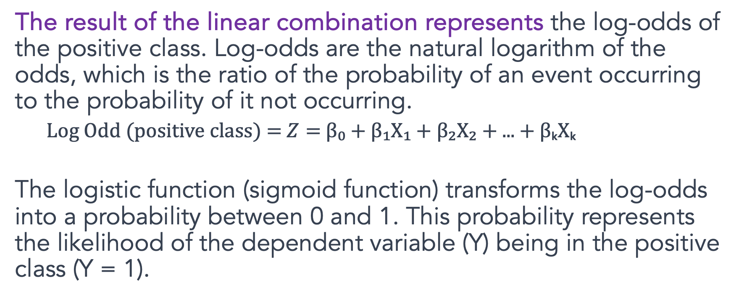
Log Odd
The result of the linear combination represents the log-odds of the positive class. Log-odds are the natural logarithm of the odds, which is the ratio of the probability of an event occurring to the probability of it not occurring.
Log Odd (positive class) = $Z=$β₀ + β₁X₁ + β₂X₂ + ... + βₖXₖ
The logistic function (sigmoid function) transforms the log-odds into a probability between 0 and 1. This probability represents the likelihood of the dependent variable (Y) being in the positive class (Y = 1).

Slide 25
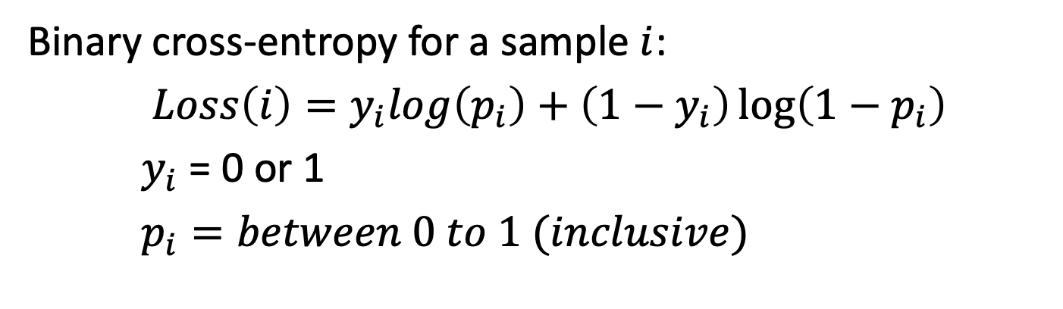
Cross-Entropy (Log Loss):
Cross-entropy, also known as log loss, is the loss function used in logistic regression.
It quantifies how well the predicted probabilities from the sigmoid function match the true class labels in the training data.
Cross-entropy is the function that needs to be minimized during training.
Binary cross-entropy for a sample $i$:
$Loss\left(i\right)=y_{i}log\left(p_{i}\right)+\left(1−y_{i}\right)\log\left(1−p_{i}\right)$
$y_{i}$ = 0 or 1
$p_{i}=between 0 to 1 (inclusive)$

Slide 26
Gradient Descent:
Gradient Descent is the optimization algorithm used to adjust the model's parameters (Coefficients) to minimize the cross-entropy loss.
It calculates the gradients of the loss with respect to the parameters (coefficients) and updates the parameters ((coefficients) ) iteratively in the direction that reduces the loss.

Slide 27
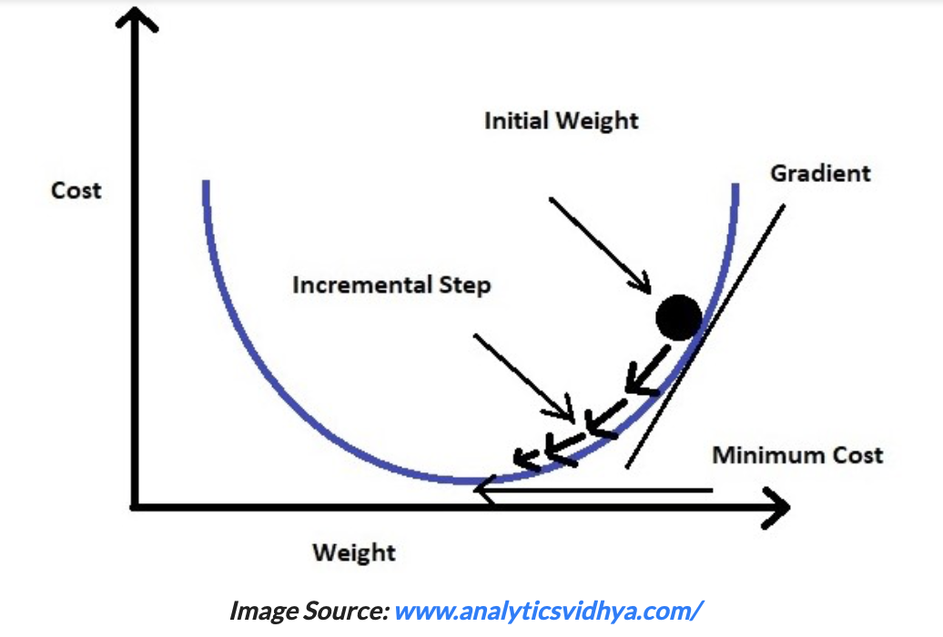
The intuition is that if you are hiking in a canyon and trying to descend most quickly down to the river at the bottom, you might look around yourself 360 degrees, find the direction where the ground is sloping the steepest, and walk downhill in that direction.

Slide 28

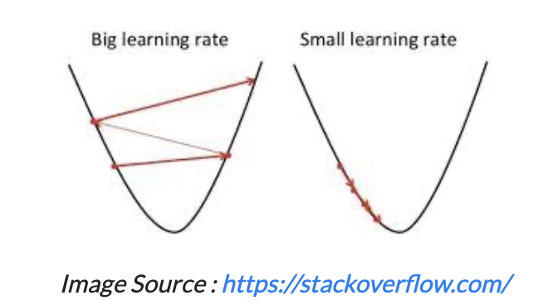
Gradient descent changes the value of our coefficients in such a way that it always converges to minimum point or we can also say that, it aims at finding the optimal weights which minimize the loss function of our model.
It is an iterative method that finds the minimum of a function by figuring out the slope at a random point and then moving in the opposite direction.
https://www.analyticsvidhya.com/blog/2021/08/conceptual-understanding-of-logistic-regression-for-data-science-beginners/

Slide 29
Model training in logistic regression involves estimating the coefficients (β₀, β₁, β₂, ...) of the model that best fit the observed data.
This is typically done using a process called maximum likelihood estimation. Here's how model training in logistic regression is performed:
Initialization:
Start with initial guesses or values for the coefficients (β₀, β₁, β₂, ...). Often, these initial values are set to 0 or random values.
Calculate Log-Odds:
Use the current coefficient values to calculate the log-odds for each data point in your training dataset. The log-odds for a single data point (i) can be calculated as:
Log-Odds(i) = β₀ + β₁X₁(i) + β₂X₂(i) + ... + βₖXₖ(i)
This calculates the log-odds of the positive class for each data point.
Apply the Logistic (Sigmoid) Function:
Apply the logistic function (sigmoid function) to the calculated log-odds to obtain predicted probabilities for each data point. The logistic function is:
P(Y(i) = 1) = 1 / (1 + e^(-Log-Odds(i)))
P(Y(i) = 1) represents the predicted probability that the data point i belongs to the positive class.

Slide 30
Compare Predictions to Actual Values:
Compare the predicted probabilities to the actual binary outcomes in your training dataset. Typically, you have values of 0 or 1 for each data point, where 1 indicates the positive class and 0 the negative class.
Calculate (Log)Likelihood/Cross-entropy:
Compute the likelihood of the observed data given the current model. The likelihood is a measure of how well the model fits the data and is calculated using the predicted probabilities and actual outcomes. The likelihood is a product of probabilities for all data points.
Update Coefficients:
Use optimization techniques like gradient descent or other optimization algorithms to adjust the coefficients in a way that increases the likelihood of the observed data. The goal is to find the set of coefficients that maximize the likelihood.

Slide 31
Repeat Iteratively:
Continue the process of calculating log-odds, applying the logistic function, comparing predictions to actual values, and updating the coefficients iteratively. This process is repeated until a convergence criterion is met, such as when the change in the likelihood becomes very small or after a predefined number of iterations.
Convergence and Final Coefficients:
Once the optimization process converges, you obtain the final values of the coefficients (β₀, β₁, β₂, ...). These coefficients represent the best-fit model that maximizes the likelihood of the observed data.
Model Training Complete:
The model training is complete when you have the final coefficients. You can now use these coefficients to make predictions on new data by calculating the log-odds and applying the logistic function.

Slide 32
Clustering

Slide 33
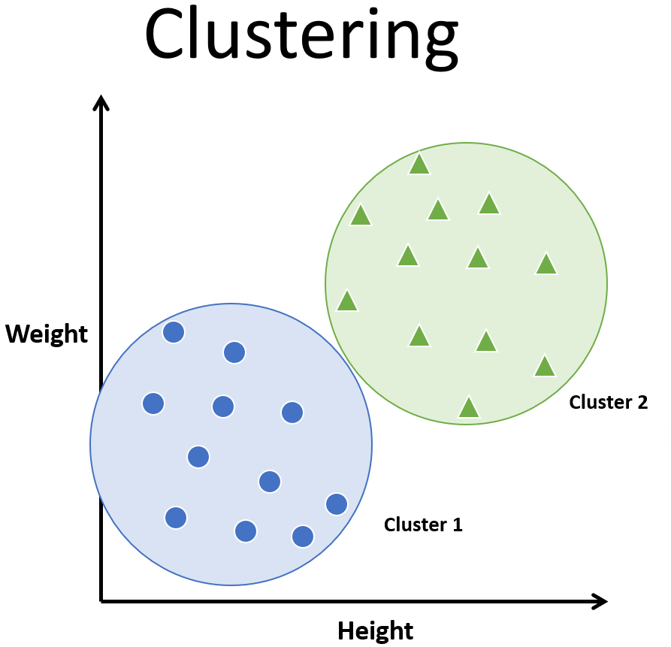
What is clustering?
The process of partitioning data into a set of meaningful sub-classes.
Purpose: Uncover natural grouping or structure
Multiple use cases
stand-alone tool to gain insight into data
preprocessing step for other algorithms
data compression
Outlier detection

Slide 34
What are clusters?
A subset of objects such that the distance between any two objects in the cluster is less than the distance between any object in the cluster and any object not located inside it.
A connected region of a multidimensional space containing a relatively high density of objects.

Slide 35
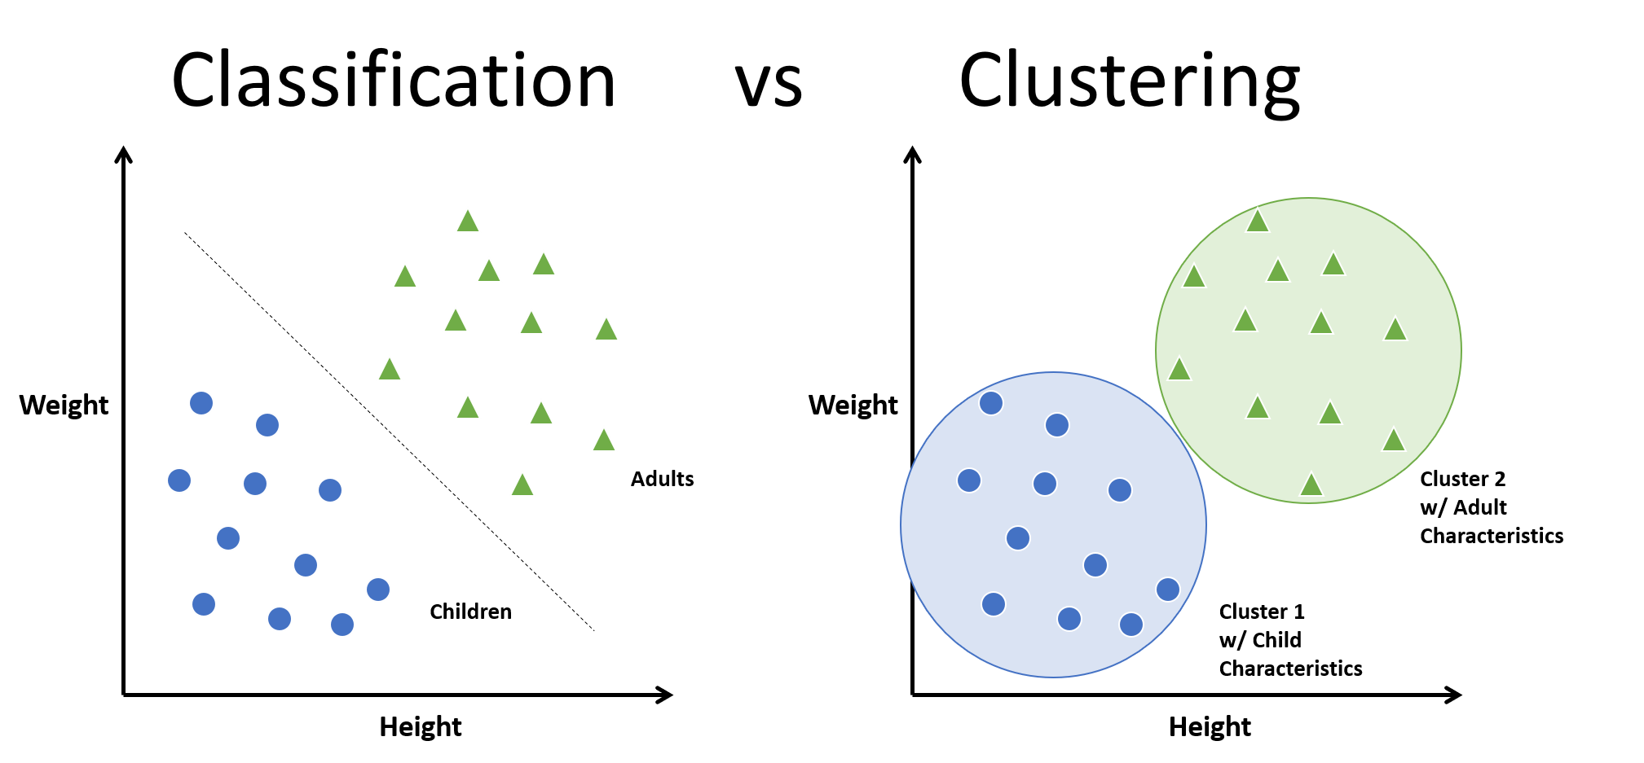

Slide 36
Clustering itself can be categorized into two types:
Hard Clustering and Soft Clustering.
In hard clustering, one data point can belong to one cluster only.
in soft clustering, the output provided is a probability likelihood of a data point belonging to each of the pre-defined numbers of clusters.

